Slide 1
Middleware Architecture
Steven Lai

Slide 2
Existing Maté Architecture
Core Components
  Engine: the main program.
  ContextSynch: provides general mechanisms for currency management. Components need to submit requests to this component when they need to execute.
  Virus: Code propagation component. Use an epidemic-like approach to spread codes.
  HandlerStore: encapsulates code storage. Each user-defined context may have a handler for storage. When a capsule is installed, HandlerStore will be notified.

Slide 3
Maté Java Tool Chain
VMBuilder: for each tailor-made VM, user may define a large number of instructions (maximum 255) and adding these instructions to the program is a tedious job. VMBuilder is used to generate a program file based on the user’s configuration.
TinyScripter: A high-level BASIC-like language used on top of Maté.
  The scripter compiles and assembles the program.
  The compiled codes will be in a capsule.
  Capsule will be evenly divided into a set of CapsuleChunkMsg and injected into the network where the Virus component is waiting to receive the message.

Slide 4
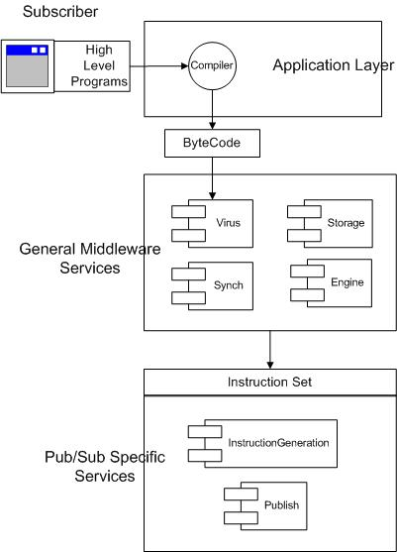
Software Architecture

Slide 5
Pub/Sub Primitives
Subscriber
  At the application layer.
  User subscribe event by using the sub() function.
Publisher
  At the middleware layer.
  A component called Publisher which simply transmit the event to the sink.
  Middleware developer use this module to publish events upon detection.

